Slide 1
Test plant energy saving
RPI Chassis layout
June 2017

Slide 2
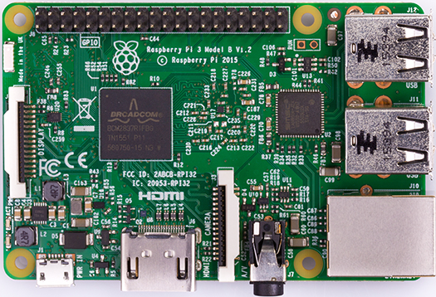
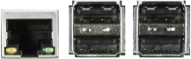
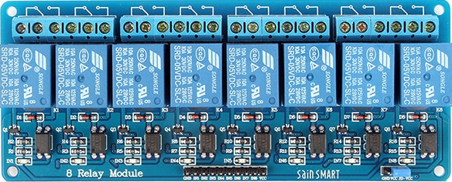
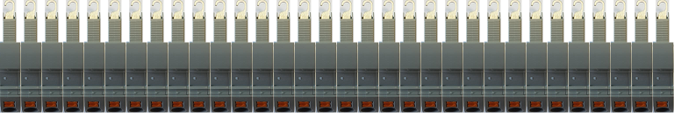
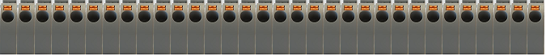
PI Relay Control Chassis layout 1
A/V
HDMI
POWER
Rear view
ETH
USB
RPI
Relay #2
Relay #1
Left view
Top view
Terminal blocks (#32)
16 16C ... … 2 2C 1 1C
Front view

Slide 3
PI Relay Control Chassis layout 2
A/V
HDMI
POWER
Rear view
ETH
USB
RPI
Relay #1
Left view
Top view
Terminal blocks (#32)
… 2 2C 1 1C
Front view

Slide 4
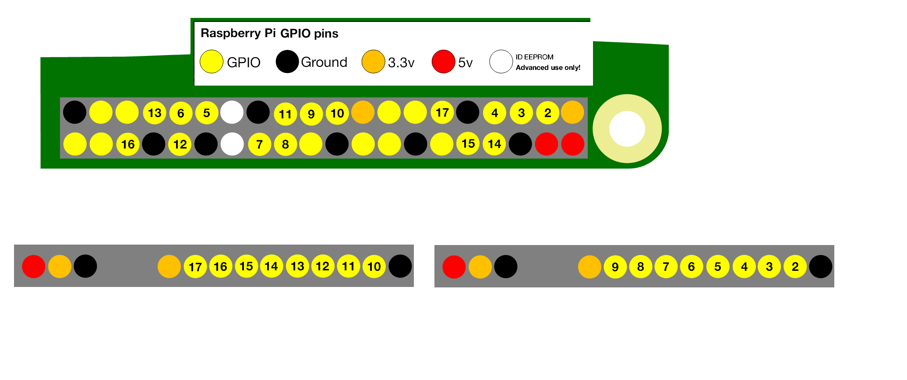
RPI Relay Control Chassis layout 3 (RPI pins connection)

Slide 5
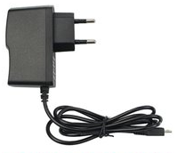
PI Relay Control components 1/3 (RPI v3)
56mm
85mm
RPI v3

Slide 6
PI Relay Control components 2/3 (8 Relay module)
138 mm
50 mm
8 Relay module

Slide 7
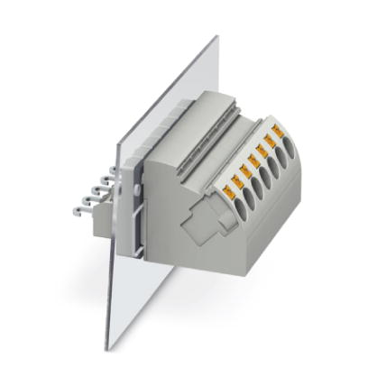
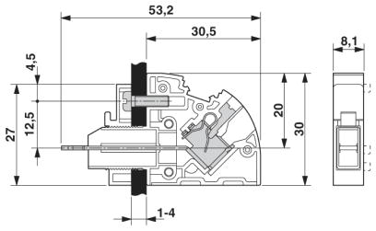
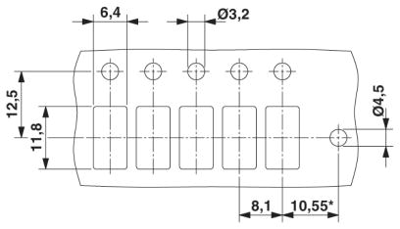
RPI Relay Control components 3/3 (Terminal block)
Phoenix PW4-POT-SL
(3059731)

Slide 8
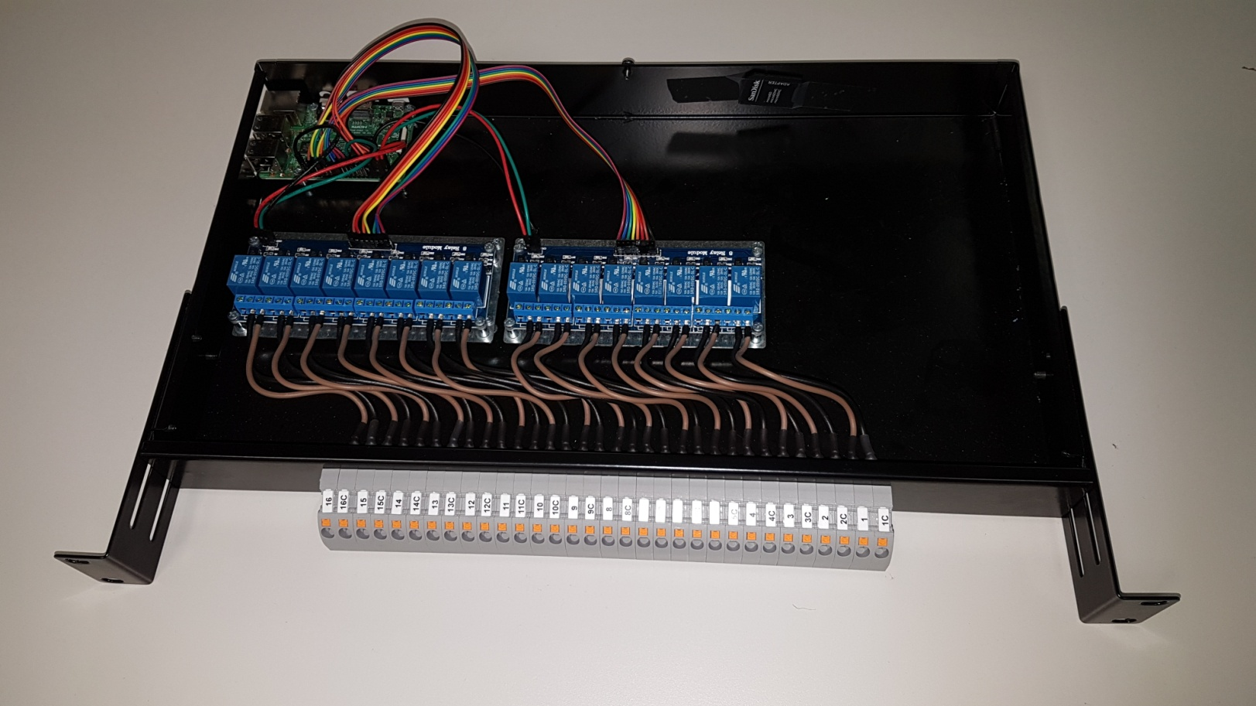
RPI Relay Control Chassis implementation 1/2

Slide 9
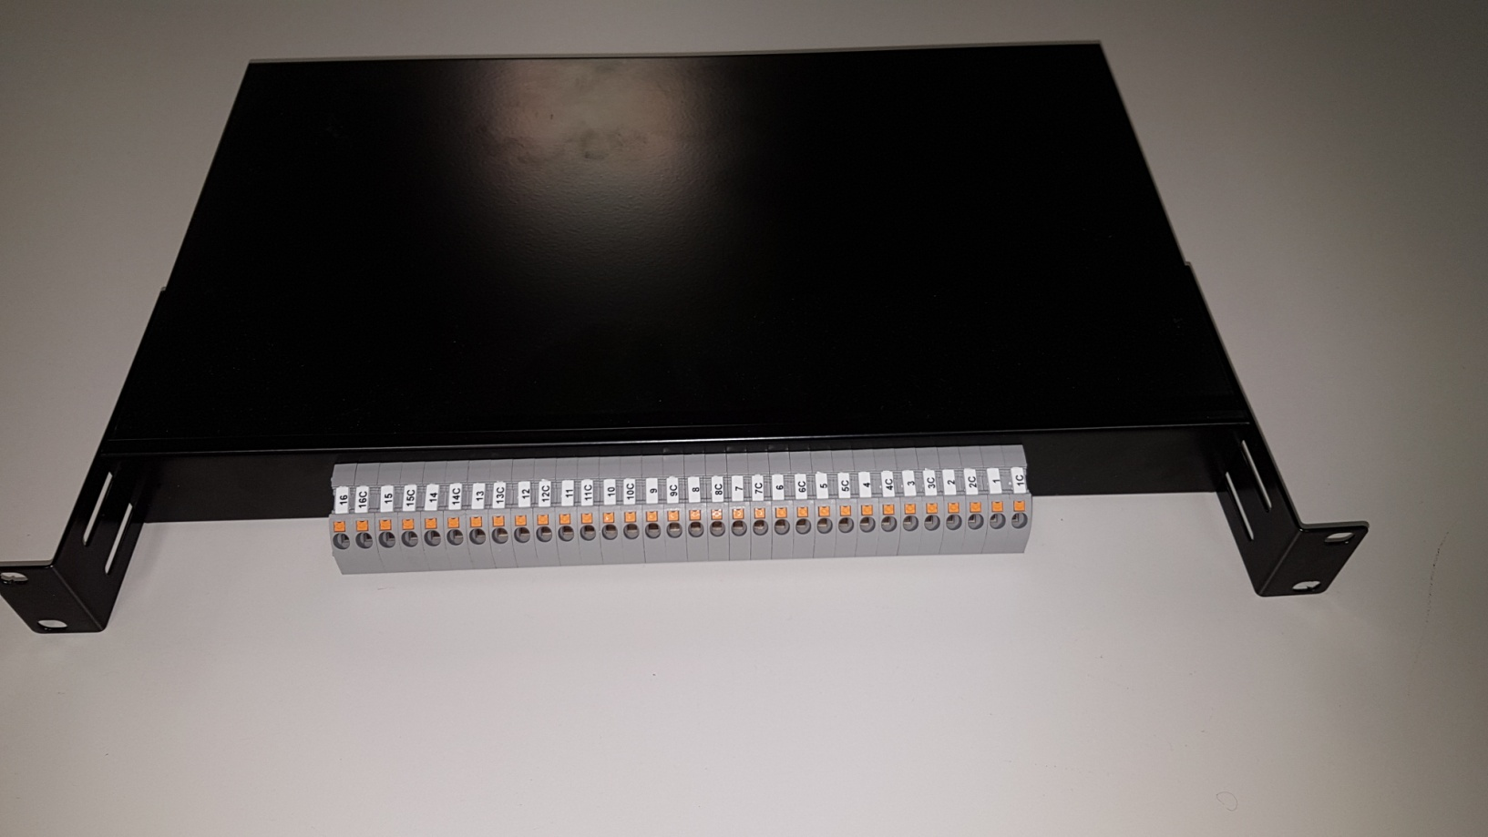
RPI Relay Control Chassis implementation 2/2

